Slide 1
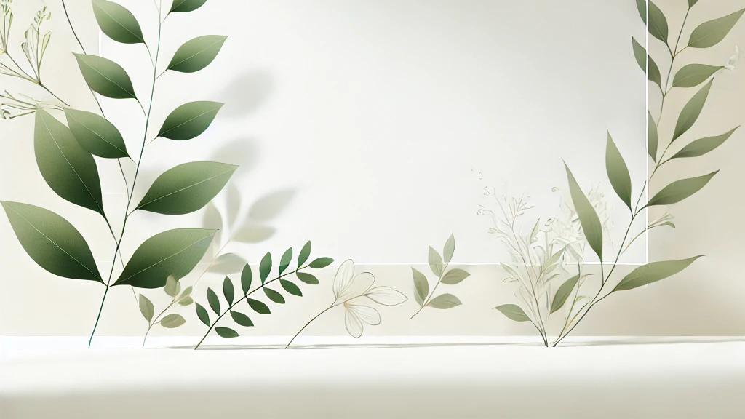
Persona Profile & Problem Statement
Pingchen Yang
Linting Chen
Keying Zhang
Team member:

Slide 2

Elias Greenwood
Name:
Description :
• Gender : Male
• Age: 24
• Occupation:
White - collar elite
• Hobbies: Gardening
Mood board or sketch:
Customer task:
When Elias is busy at work, he wants to integrate gardening into his busy life, so he can take care both work & interest
Influencers:
• Family
• Partner
• Friends & Social circle
Pains:
• Time difficulties
• Plants wilt
• Distracted
Trends:
• Market & Work
• Sustainability
• Tech & Gardening
• Social media
Gains:
• Good mood
• Home improvement
• Improved work
efficiency
Use cases:
• Where? Balcony or Backyard
• What? Create a relaxing greenspace
• How? Automated watering system

Slide 3
Problem Statement
Our busy white-collar professional needs a way to seamlessly integrate gardening into his demanding work schedule because maintaining a relaxing green space improves his mood and work efficiency, but time constraints and distractions pose a challenge because they lead to neglected plants, increased stress, and difficulty balancing personal interests with professional responsibilities.
Insight：
Maintaining a relaxing green space improves his mood and work efficiency
User Type：
Busy white-collar professional
Verb：
Seamlessly integrate gardening into his demanding work schedule
Constraint：
Time constraints and distractions
Consequence：
Lead to neglected plants, increased stress, and difficulty balancing interests with work

